Slide 1

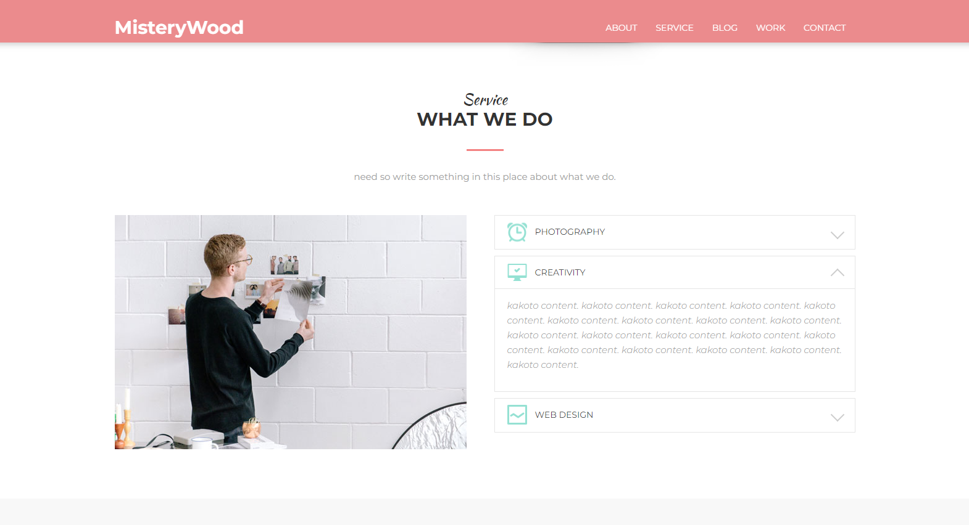
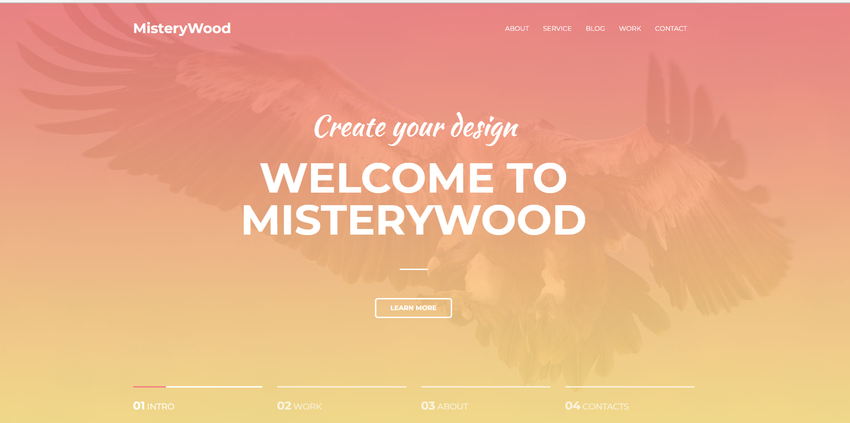
Test case how to use MISTERYWOOD webpage

Slide 2
The first page that meets you is the main one. Here you see the navigation bar (it will follow you on all pages of the site)
and
«Learn more» button (This button will redirect you to another page, but this page is currently still under development)

Slide 3
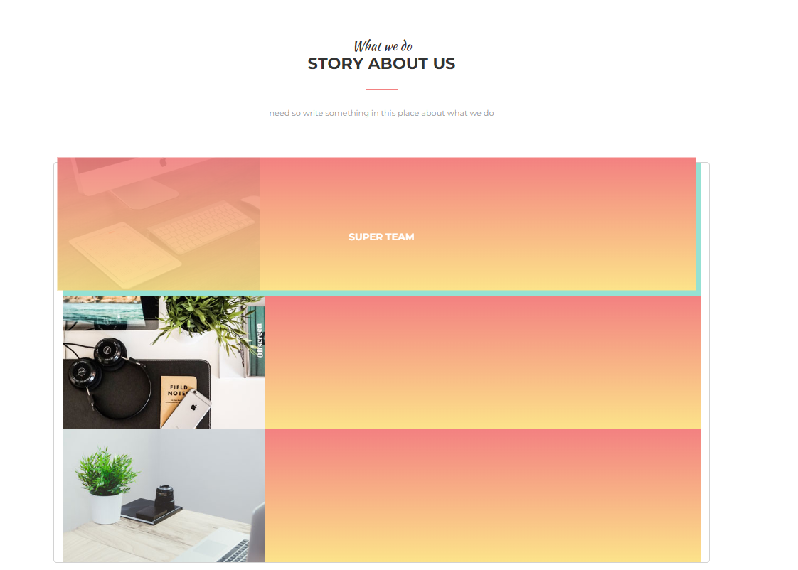
What we do page
(animates when hovering over this block)

Slide 4
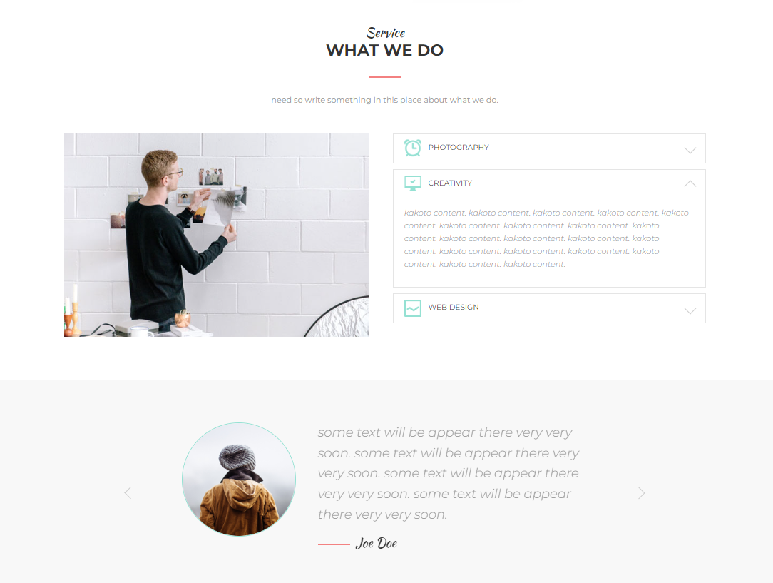
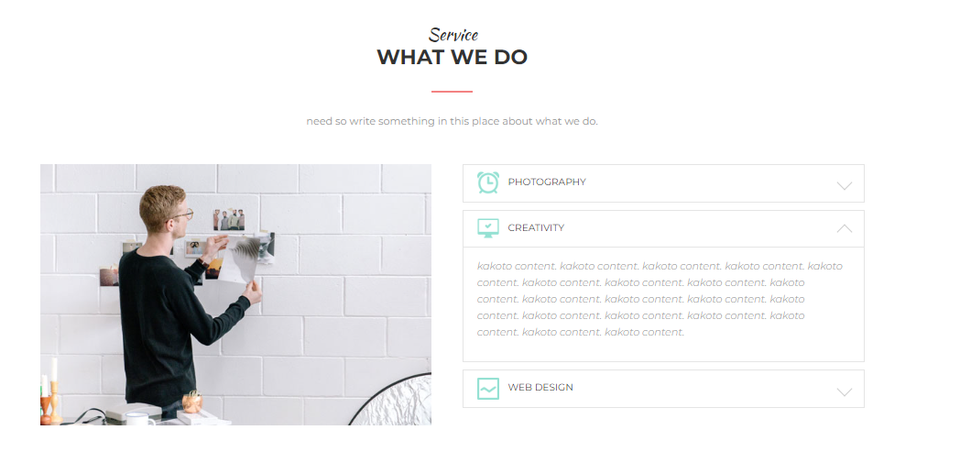
Service page
Three accordion objects
(by clicking on which text appears )
Service page
Reviews
(a block with reviews that you can scroll through by clicking on the buttons)

Slide 5
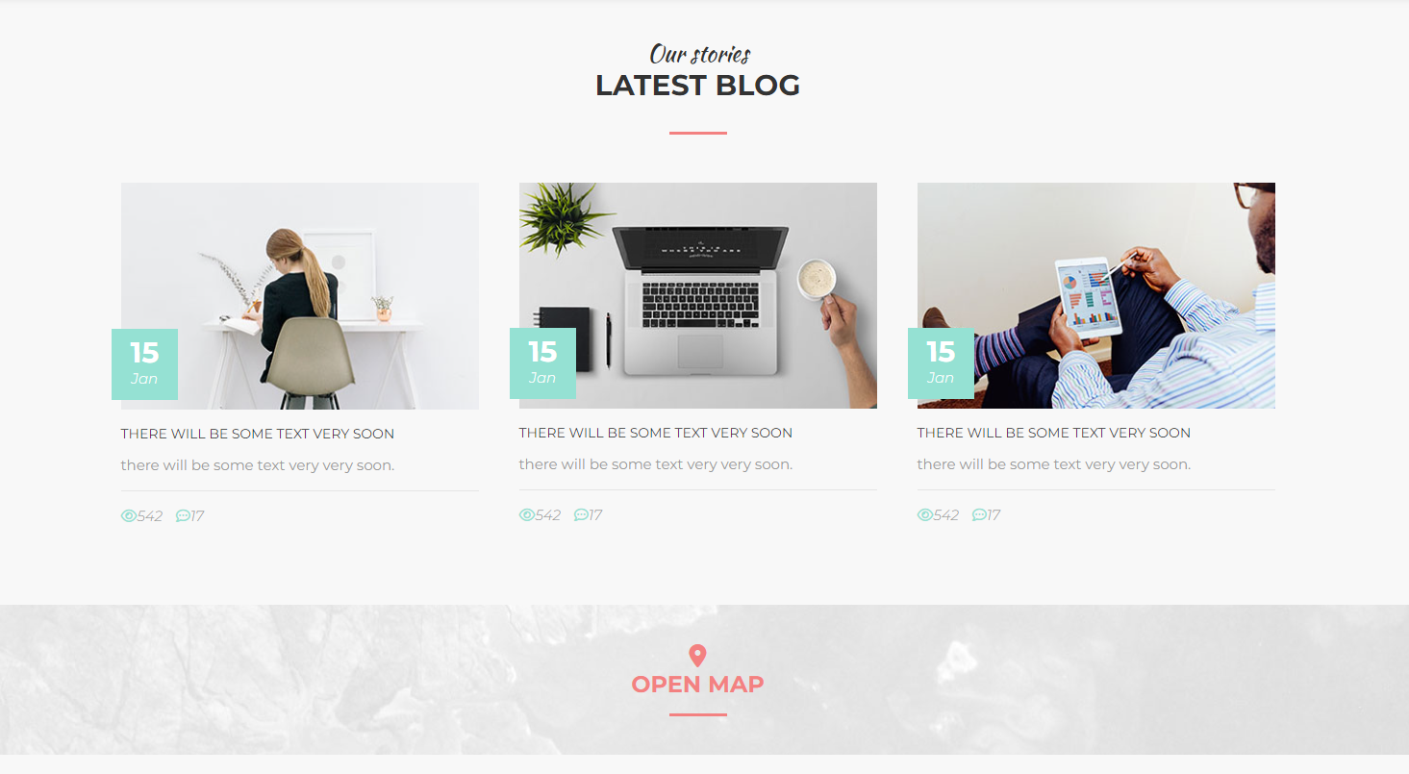
Blog page
(By clicking on this button, opens the map and shows where the company is located)

Slide 6
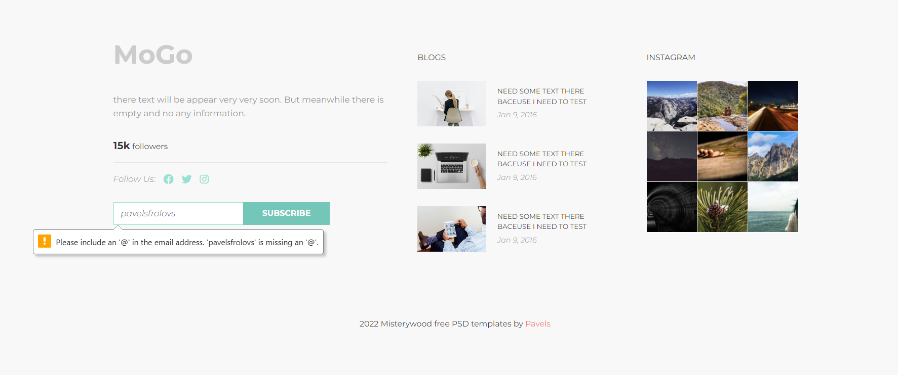
Last page
Subscribe button
(1. Redirects you to another page. 2. Warns that the "@" character is required for input)

Slide 7
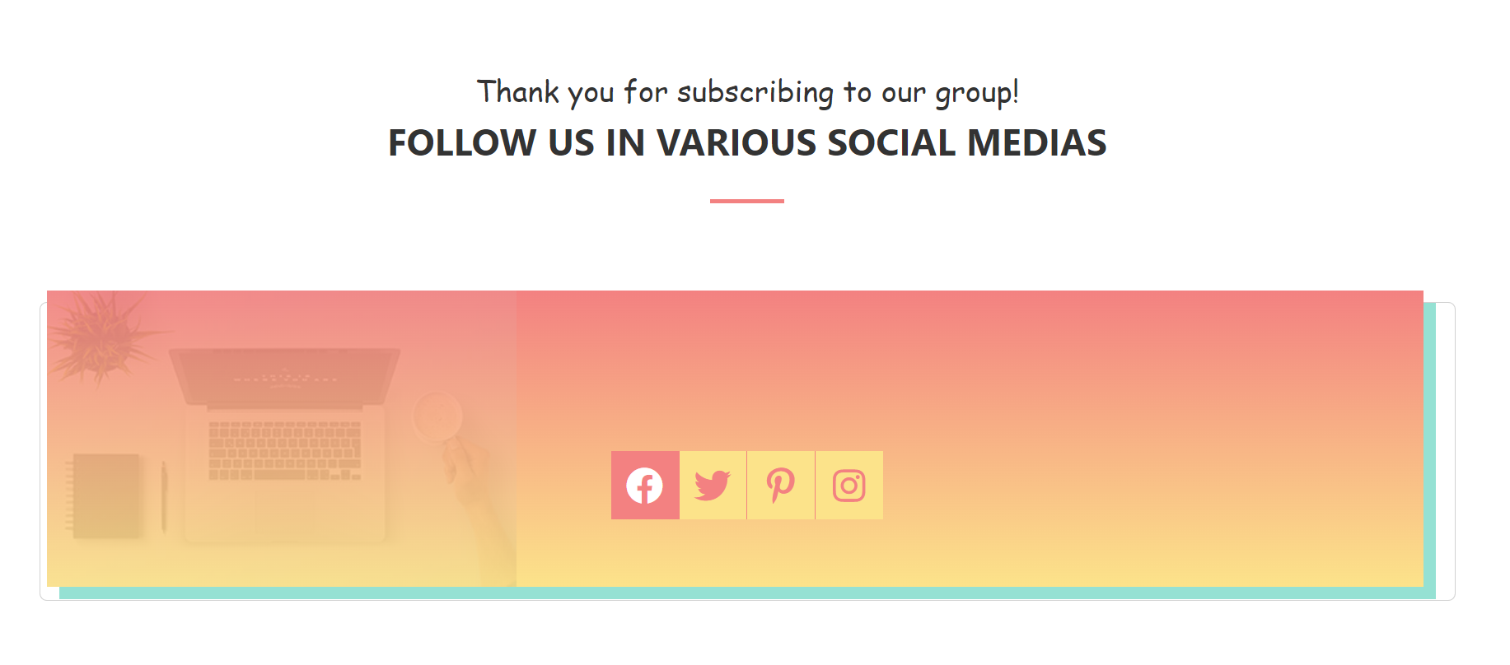
Thank you page for subscribing
(clicking on the icon of any social media redirects to the corresponding portal)

Slide 8
Last page
Subscribe button
(1. Redirects you to another page. 2. Warns that the "@" character is required for input)

Slide 9
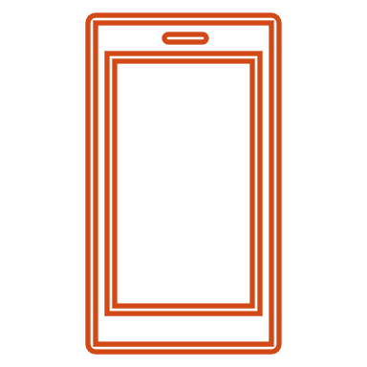
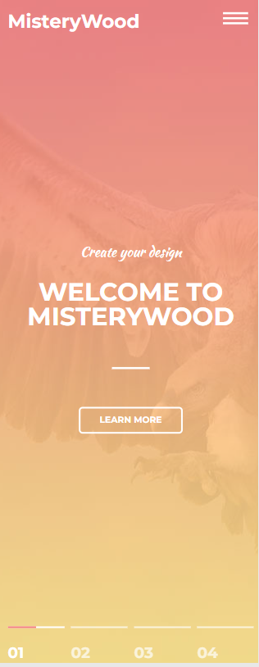
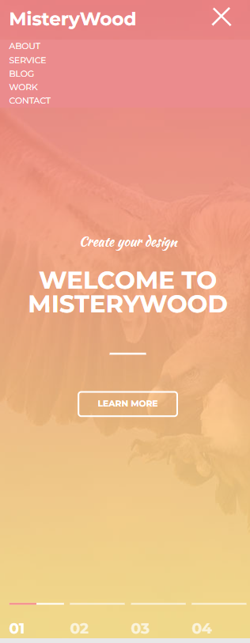
There is also a mobile version of the site. (In this mode, the navigation bar is labeled as a "sandwich" and in the closed position, the navigation bar is not visible.
To see the navigation bar, you need to go back to the button due to the three bands that transform into a cross when you click)

